Slide 1

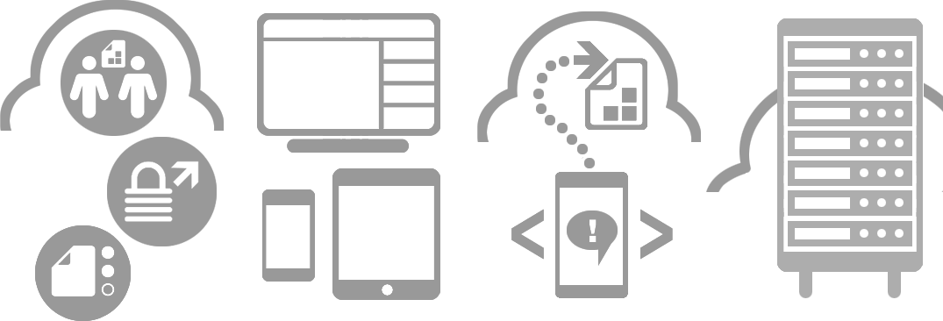








User scenario with Point.io web console
Julien Gaye
Sales Engineer
+44 7708 147 445
jgaye@point.io

Slide 2
User scenario
A Project User can only access projects he has been invited to, and interacts with documents accordingly to the rights given by the Project Manager.
The next slides present the required component for a user interface, and where they can be found in the current web console.

Slide 3
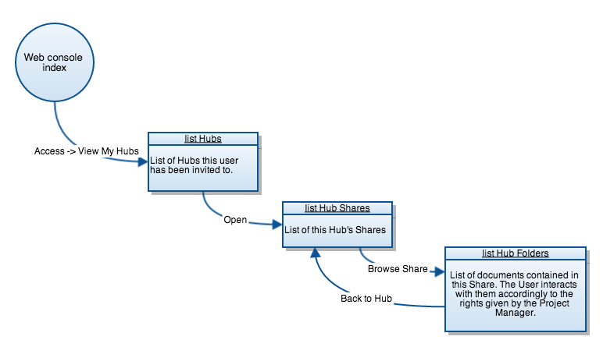
Click a shape to access its description directly.

Slide 4
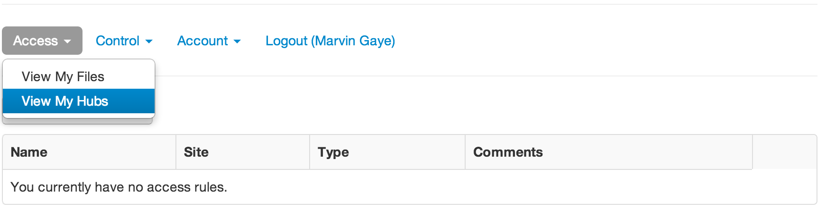
To get a view of the projects he/she is working on, the User needs to access the list of Hubs he/she is member of. A project is represented by a Hub which is a virtual room where the Project Manager share all the relevant documents with all of the project’s members.
To see his/her Hubs, the User goes to Access -> View My Hubs in the web console.
No other management option should be available for the User.

Slide 5
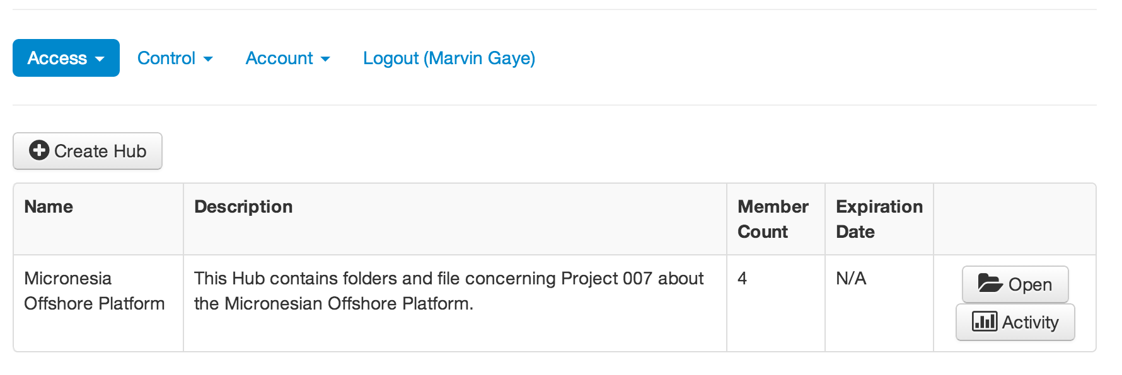
The list of Hubs the User has been invited to is displayed. Each Hub entry shows a name, a description of the Hub, a count of its members, and an expiration date (if one has been set by the Project Manager). To open a Hub and get a view of its shares, the user clicks on the Open button of the Hub entry’s “Open” button.
The “Create Hub” and “Activity” buttons should be removed from the User’s web console interface.

Slide 6
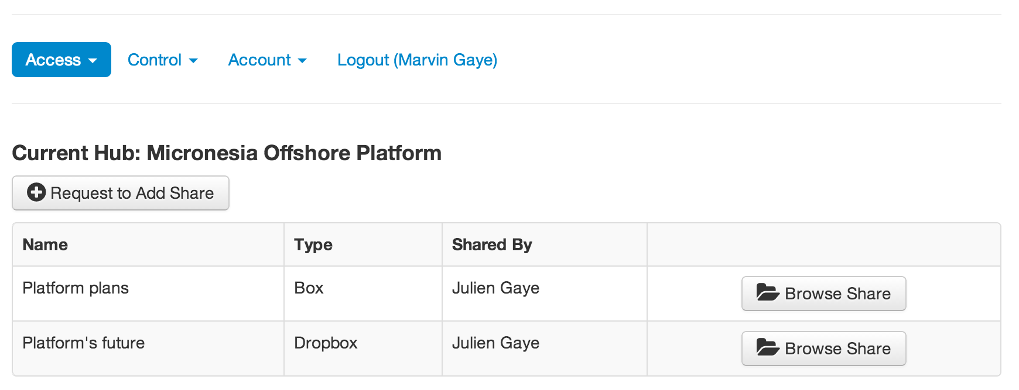
The list of Shares gathered in the Hub is displayed. Each Share is a folder of documents added by the Project Manager to the Hub, and shows a name, a storage type and the name of the Project Manager who added it.
To browse Share’s documents, the user clicks on the “Browse Share” button of the corresponding Share.
The “Request to Add Share” button should be removed from the User’s web console interface.

Slide 7
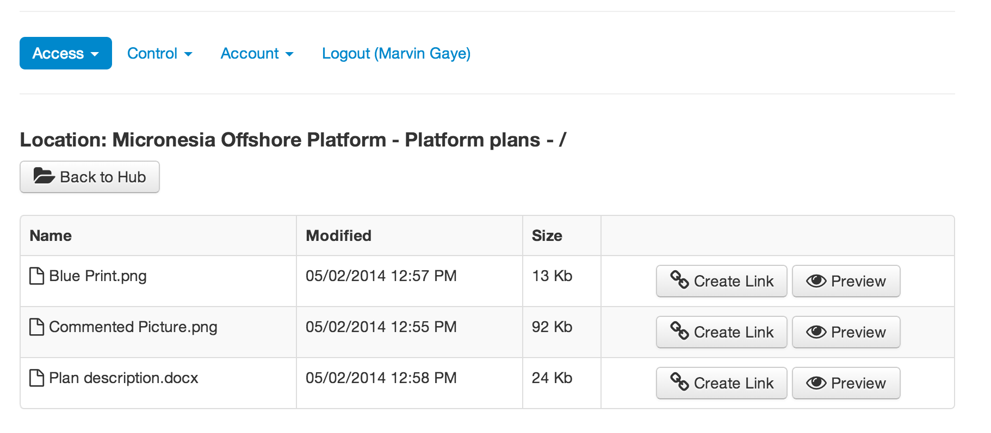
The documents contained in the Share are displayed to the User.
The User’s rights on a particular Share’s documents are set by the Project Manager when adding the Share, and the User can only interact with the documents accordingly to those rights.
Here for example, the User can only Preview a file, but can’t download, upload or edit folders or files.
The “Create Link” buttons should be removed from the User’s web console interface.

